Slide 1
Particle Transformer
Oral Project Update
Andrew Masek, Abijit Jayachandran, Juan Yin
1

Slide 2
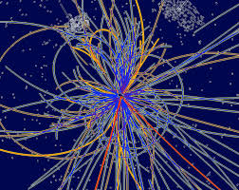
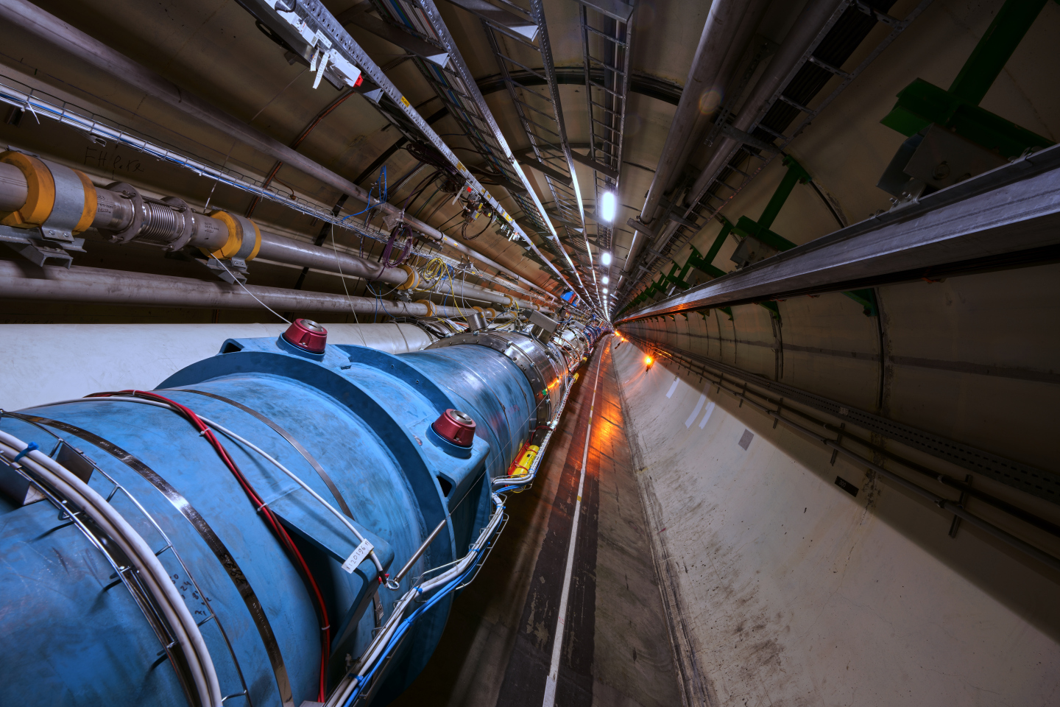
Context
2

Slide 3
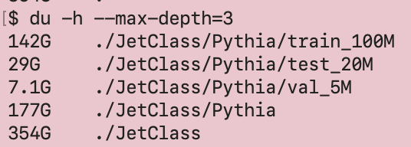
Particle Colliders have a data problem
Generates up to 100 TB of Jetstream data per second
Machine learning!
Store results, not raw data
⁉
3
Notes:
https://indico.cern.ch/event/1127278/contributions/4731215/attachments/2391144/4087626/hls4ml_future_a3d3.pdf

Slide 4
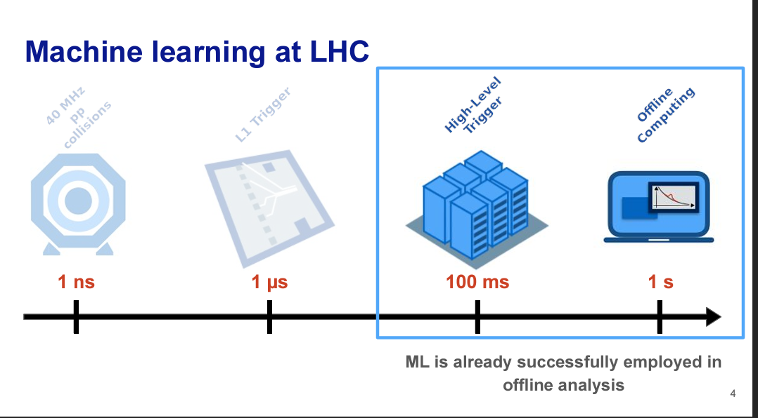
Existing Solutions
Smaller models with lower accuracy
Larger models with better accuracy
Particle Transformer (Qu et al.)
Post experiment data analysis
Image from HLS4ML
4

Slide 5
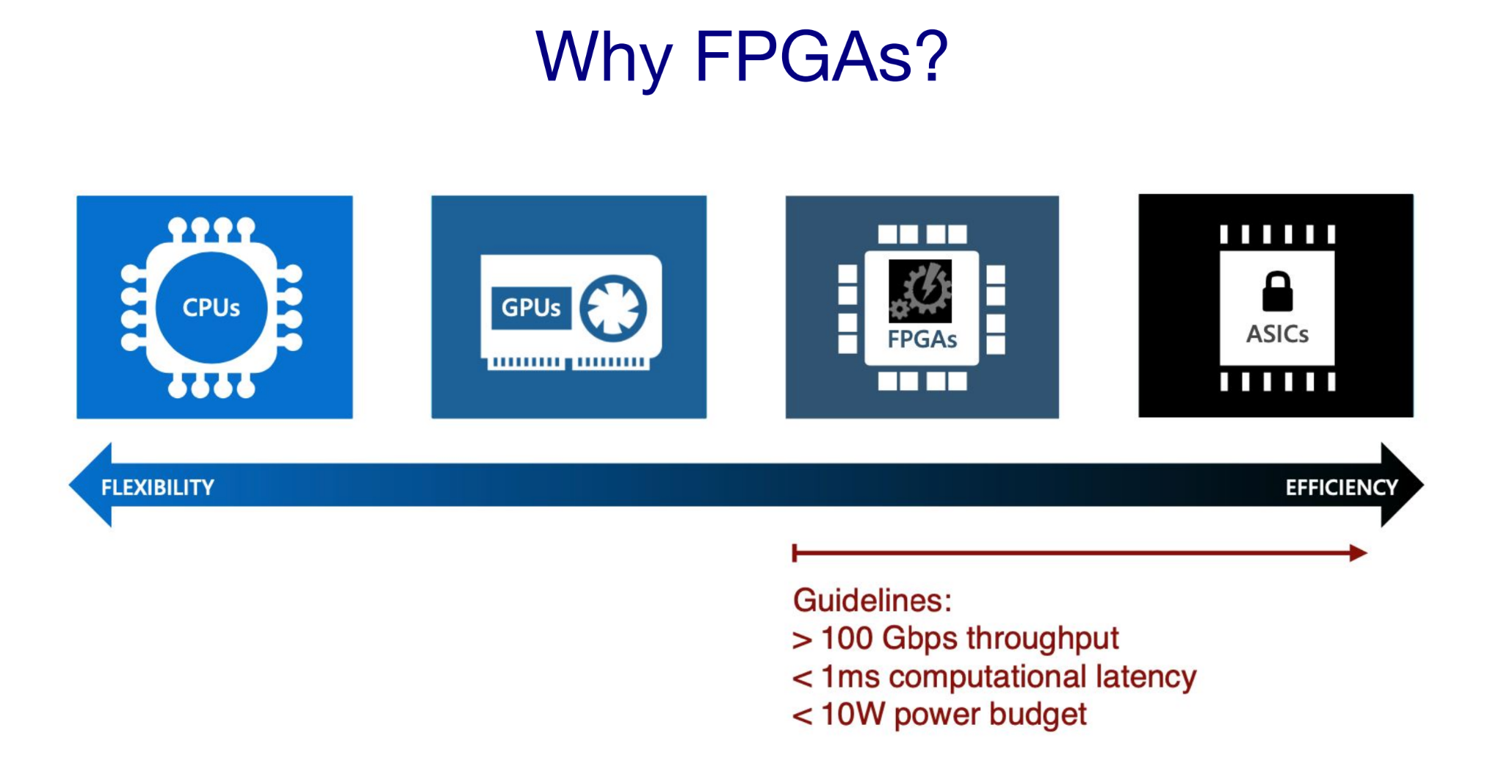
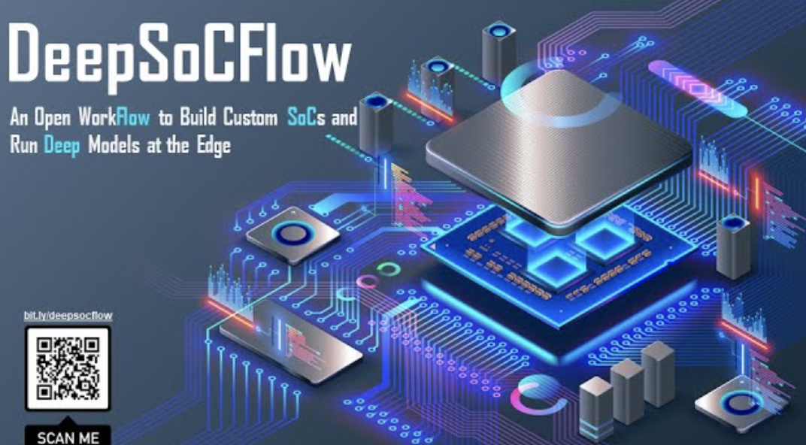
Introducing FPGAs…
Traditionally GPUs are used for machine learning inference
FPGAs - faster, cheaper, and more efficient
DeepSOCFlow
Image from HLS4ML
5
Notes:
However, it is not possible to implement deeper neural networks on HLS4ML;
What we bring to the table / Our idea

Slide 6
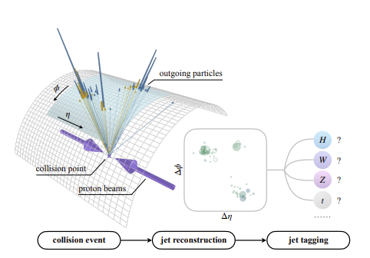
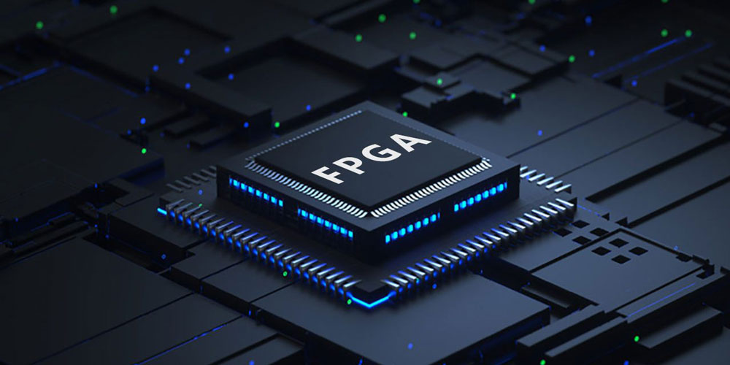
Our Solution
Want to use SOTA Particle Transformer model
Quantizing the model to make it faster/ more efficient
Deploy to FPGA using DeepSOCFlow
6
Notes:
However, it is not possible to implement deeper neural networks on HLS4ML;
What we bring to the table / Our idea

Slide 7
How do we get there?
Pytorch
Keras
QKeras
FPGA
OUR PROJECT
DeepSoCFlow
7
Notes:
Particle Transformer already exists and is implemented in the Pytorch library
We need to reimplement the Particle Transformer in the QKeras Library to make it compatible with DeepSOCFlow (make it clear that the scope of this quarter is just to make the model in QKeras, DeepSOCFlow outside of scope)

Slide 8
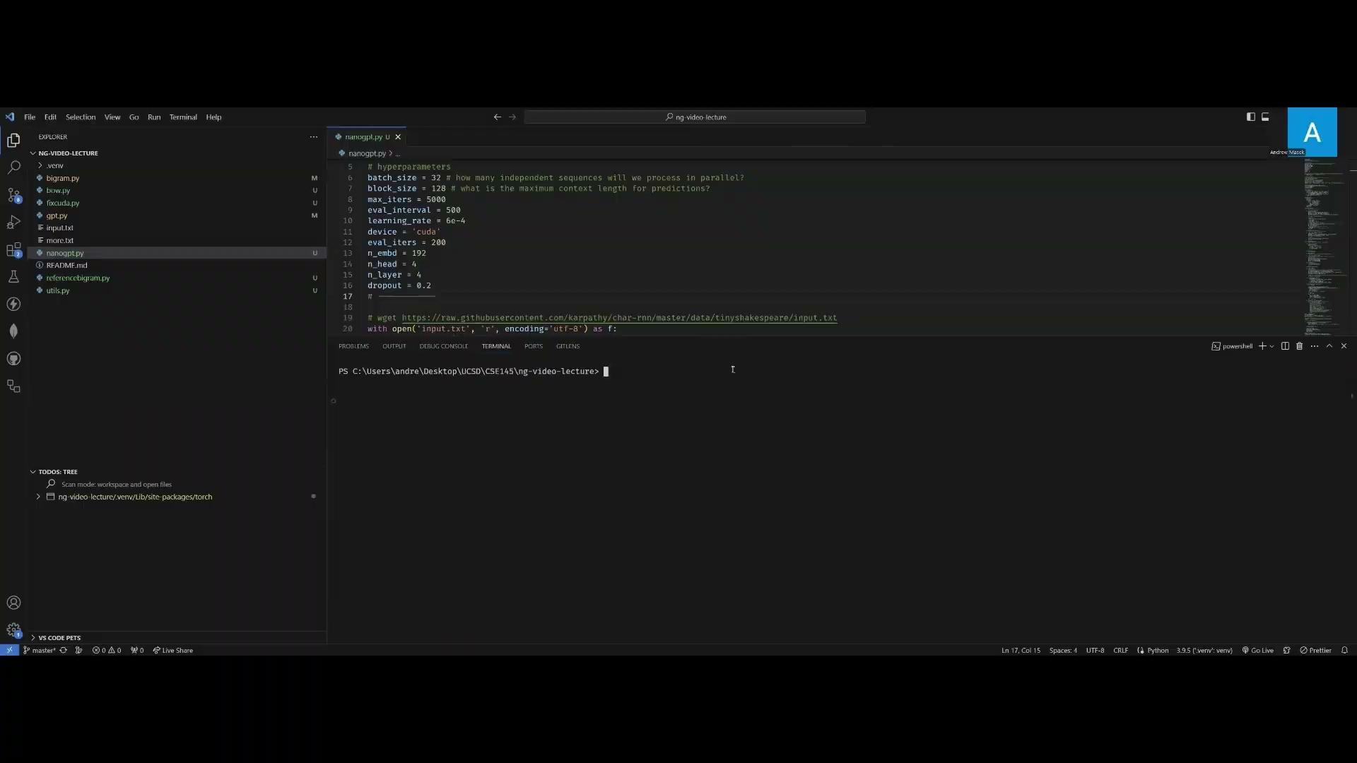
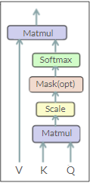
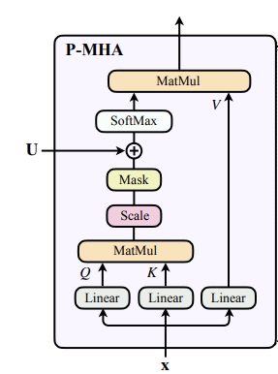
Where are we at?
We implemented NanoGPT as our MVP
Rationale
Learning Transformer architectures
Pytorch to QKeras conversion
Similar to Particle Transformer
8
Typical Self-Attention Head
Particle Attention Head
Notes:
We implemented a similar model in QKeras called NanoGPT
Go into minimal detail about similarities between the models
Video demo of NanoGPT model

Slide 9
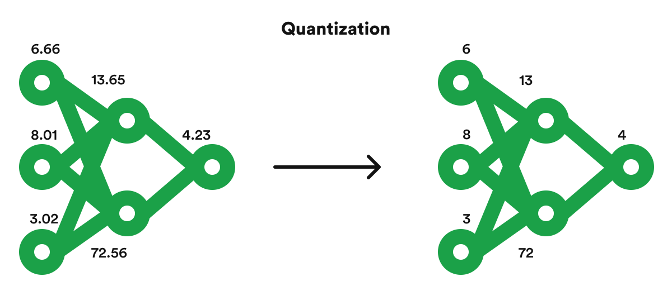
Next steps
Particle Transformer conversion
Experiment with quantization
Can try other techniques like pruning
Image from rinf.tech
Pytorch
Keras
QKeras
Particle Transformer
9
Notes:
Take what we learned from porting nanoGPT and reimplement the Particle Transformer
Experiment with different quantization methods to make the model smaller and faster while maintaining accuracy

Slide 10
Thank you for listening
Questions?
https://docs.google.com/presentation/d/1ZOtYuZJpTo6RWvHSNxrew72-rlm6AaK2h9aaQVfT1Fk/edit#slide=id.g2d1d32f9462_0_0
10

